Slide 1

Mess – Eat
Guided By : Prof. Ajaykumar patel
20BCE503 – Jaimik Chauhan
20BCE506 – Dhruti thakrar

Slide 2
Outline
Introduction
Database Design
Admin Module
Mess Module
User Module

Slide 3

Introduction
As a bachelor how many time you crave for home food near your PG/Hostel.
We’re Providing Platform that will help bachelors/user to get good home food.
Bachelor/User can make an order and also take an subscription from Mess.
User/Bachelor can View menu from all the messes.
Mess User can add/update/delete dishes and subscription services.
Admin can Manage Mess and Users.

Slide 4
Technology Used
Building with MERN Stack.
MongoDb : NoSQL Database
Express.JS : Node.JS Web Framework
ReactJS : Client Side Javascript Framework
NodeJS : the premier JavaScript Web Server

Slide 5
Functionality
User
Add / Update Profile
Add / Update / Remove Addresses
Add / Update / Remove Dish from Cart
Place an Order
Buy a Subscription from Specified Mesh
User can View Meshes and Dishes Related to Selected Mesh
Mess User
Add / Update / Remove Dish
View Subscribed User Details
Download Dishes as PDF / CSV file

Slide 6
Functionality
Admin
Add / Update / Remove User
Add / Update Profile
Add / Update / Remove Mess
Manage Orders
View User Addresses
View Added Dishes By Mess

Slide 7
Database Design

Slide 8
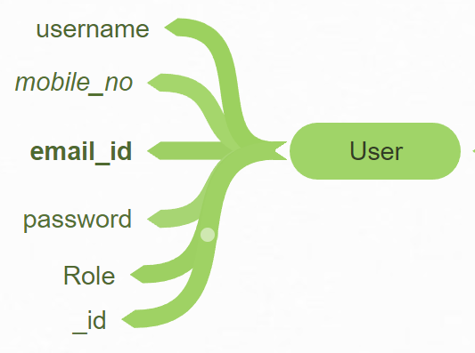
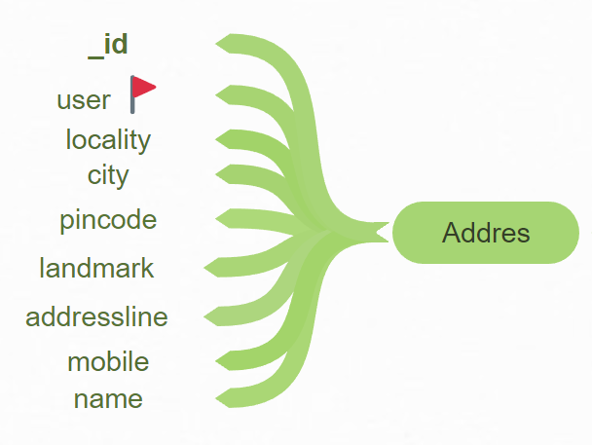
Database Design
User Schema
(Role Identify If User is Consumer or Admin)
Address Schema
Each User can store N number of addresses.
User is referenced from USER Schema

Slide 9
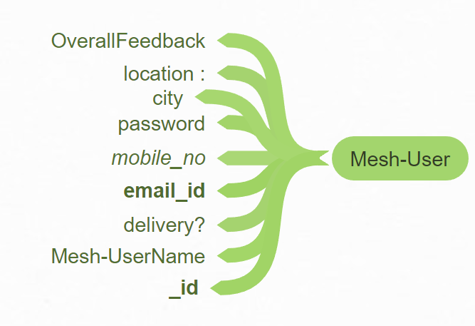
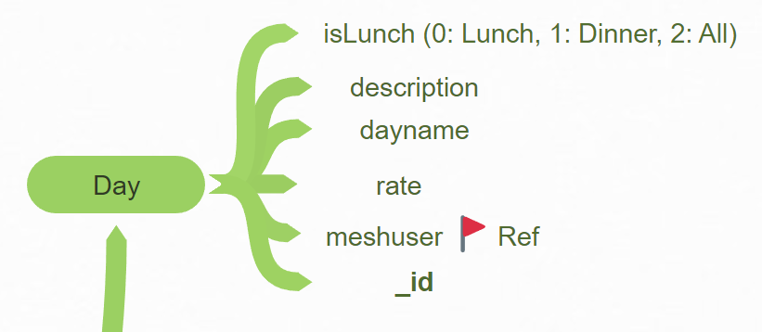
Database Design
Mess-User Schema
(Store Mess Details)
Day Schema
Mess-User is referenced from MESS_USER Schema

Slide 10
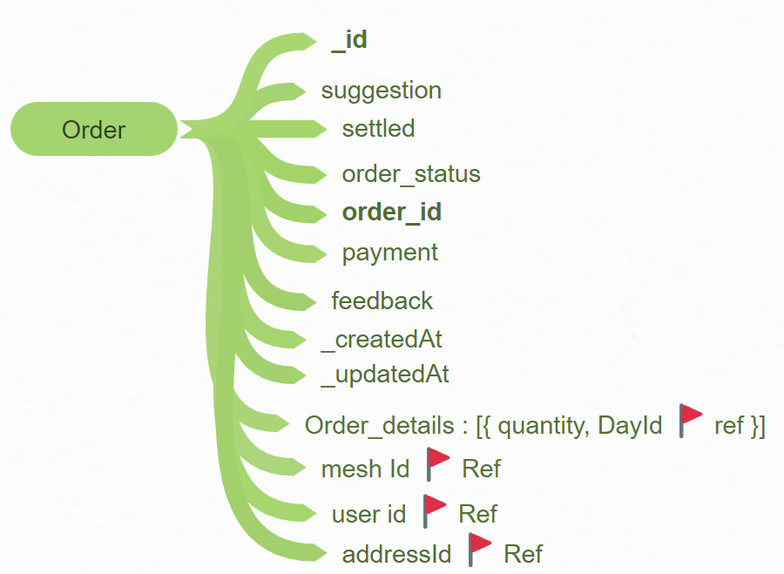
Database Design
Order Schema
Store Order Details
MessID Reference From MESS-USER Schema
USERID Reference From USER Schema
Dishes Reference From DAY Schema and stored in Objects.
AddressId Reference From Address Schema

Slide 11
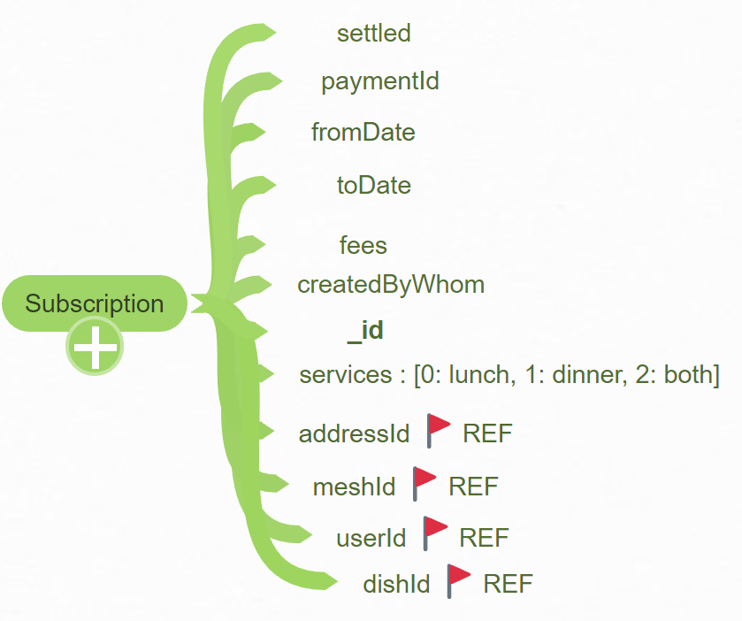
Database Design
Subscription Schema
Store Subscription Details
MessID Reference From MESS-USER Schema
USERID Reference From USER Schema

Slide 12
Admin Module

Slide 13
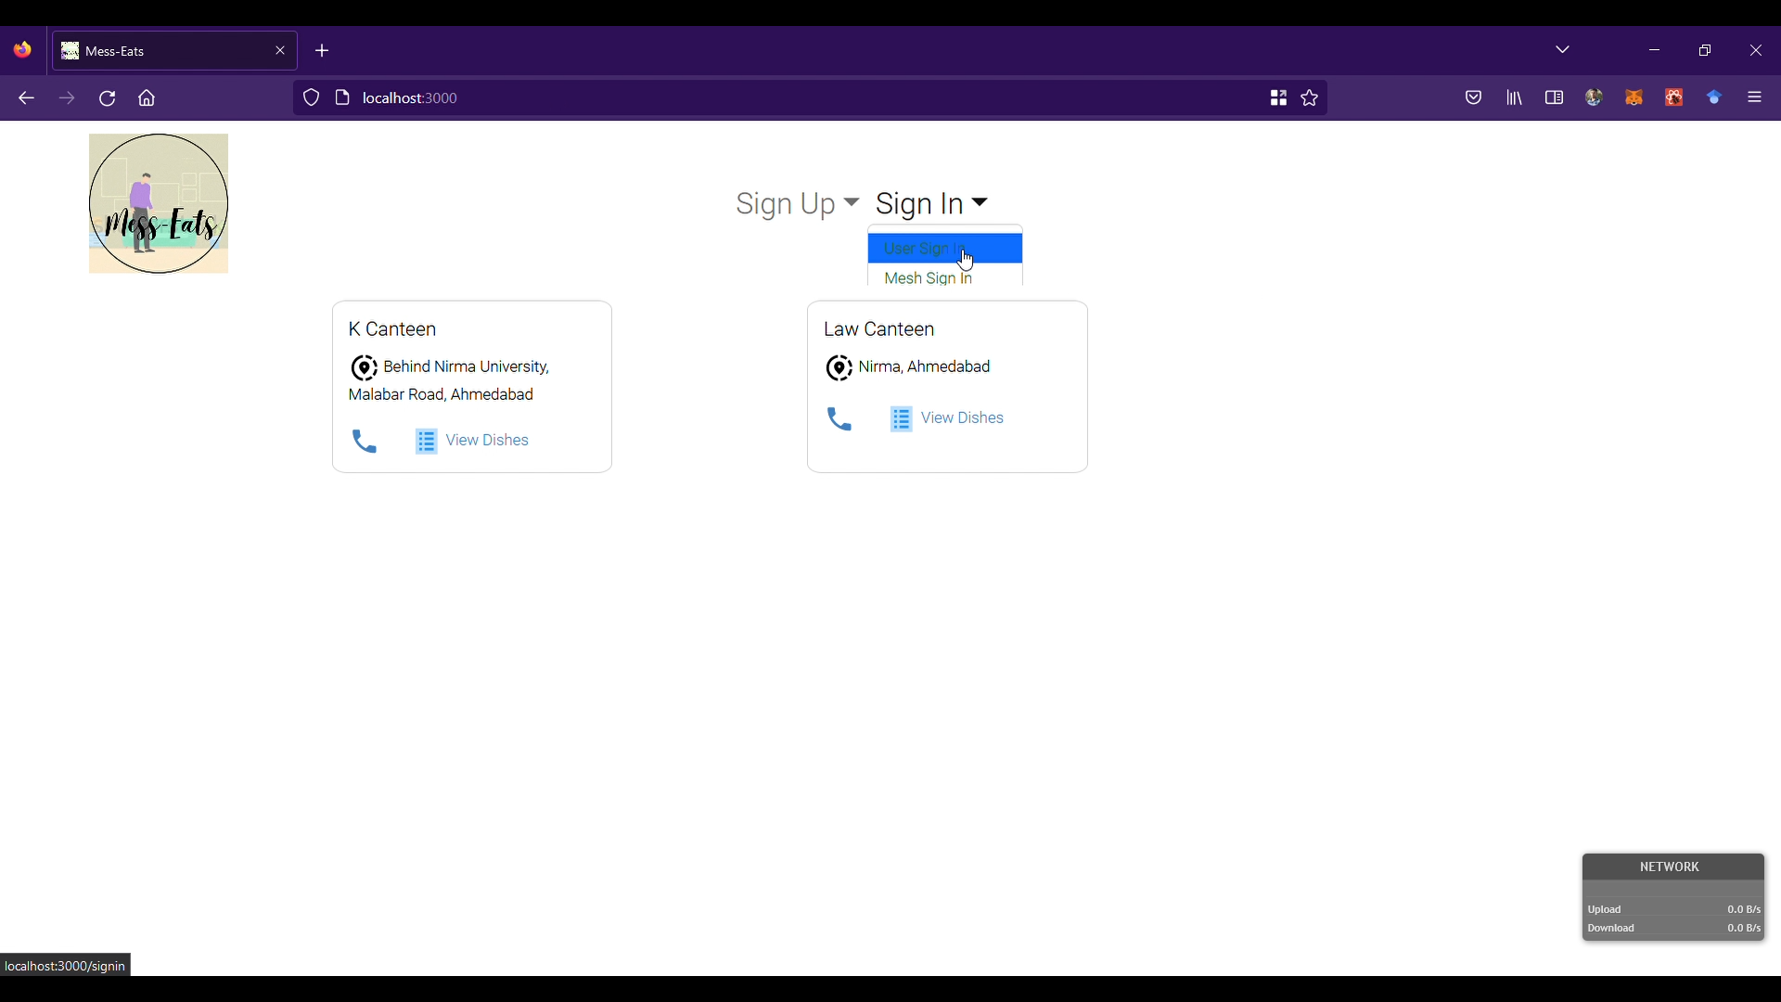
Admin Module (Home Page)
Fig 1.1 : Home Page

Slide 14
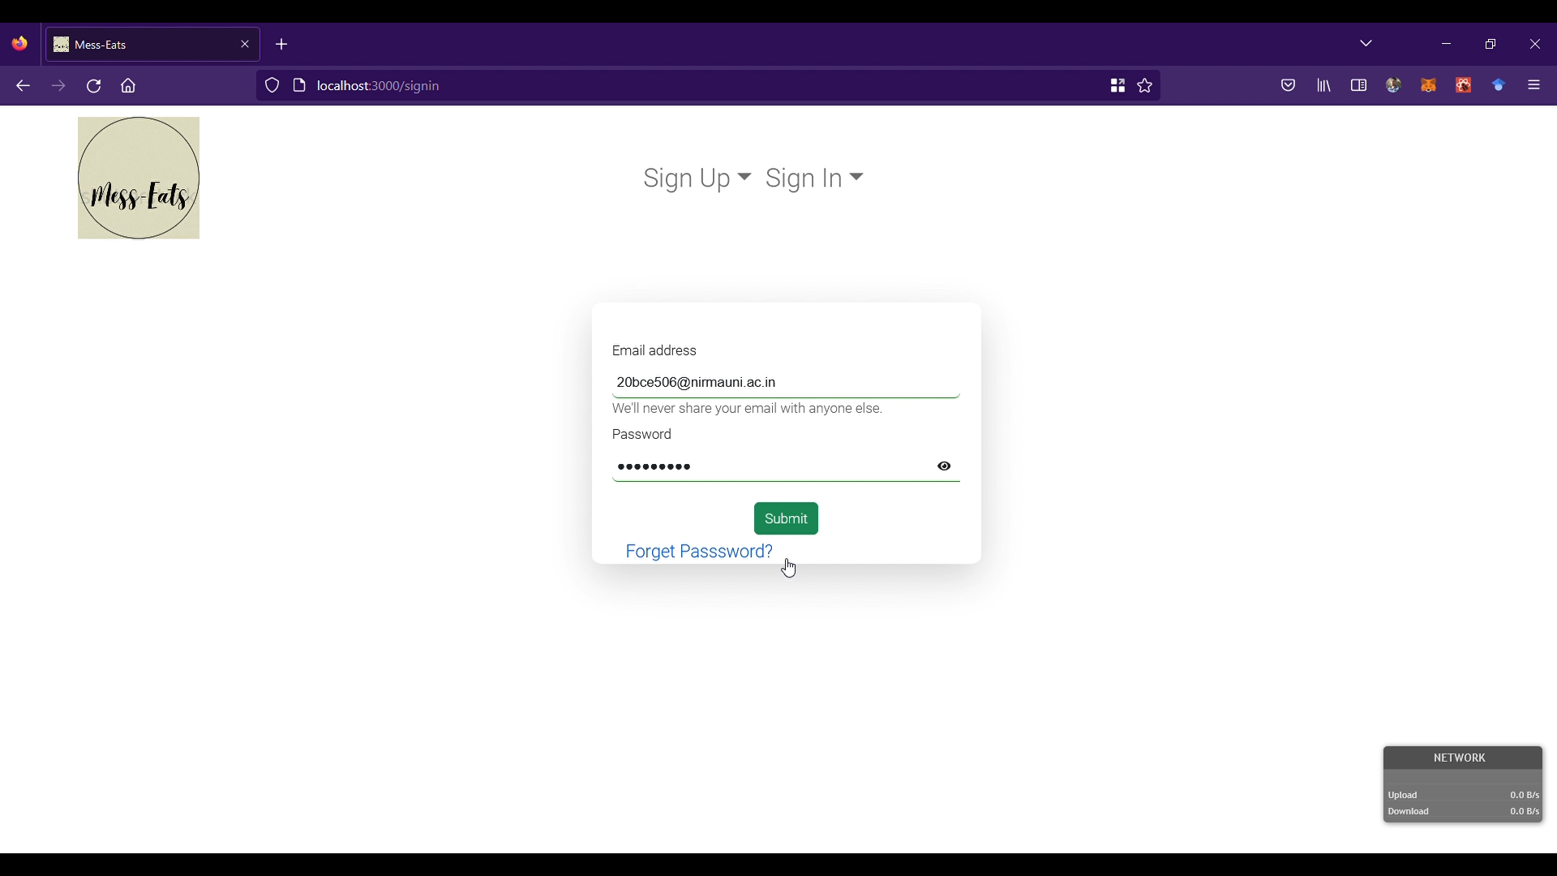
Admin Module (Sign In Page)
Fig 1.2 Sign In Page

Slide 15
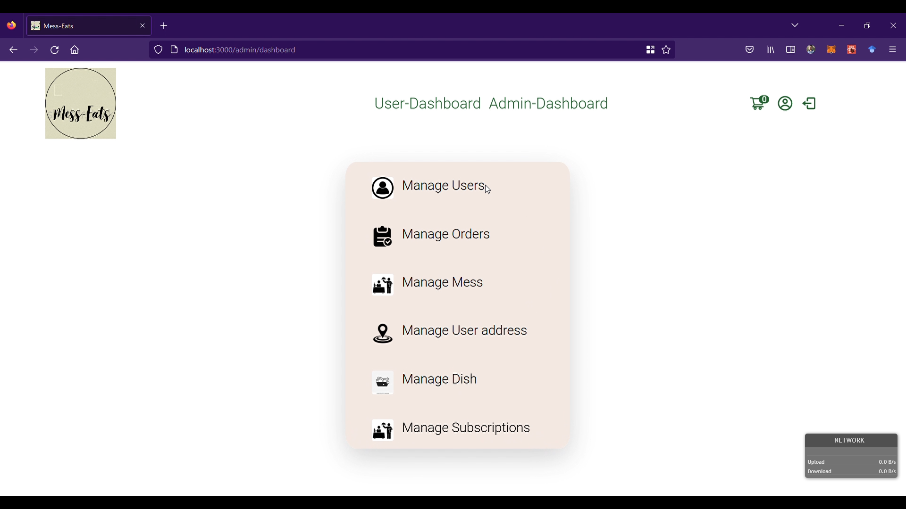
Admin Module (Admin Dashboard)
Fig 1.4 Admin Dashboard

Slide 16
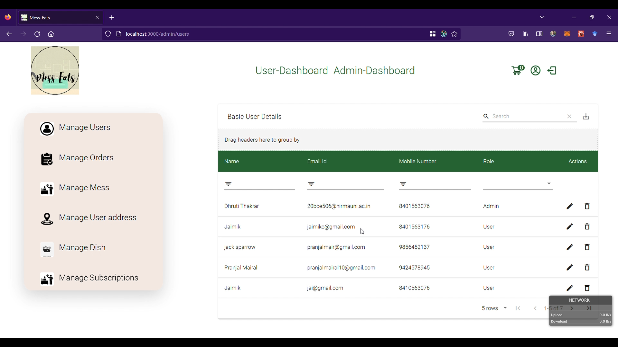
Admin Module (Manage Users)
Fig 1.5 Manage Users

Slide 17
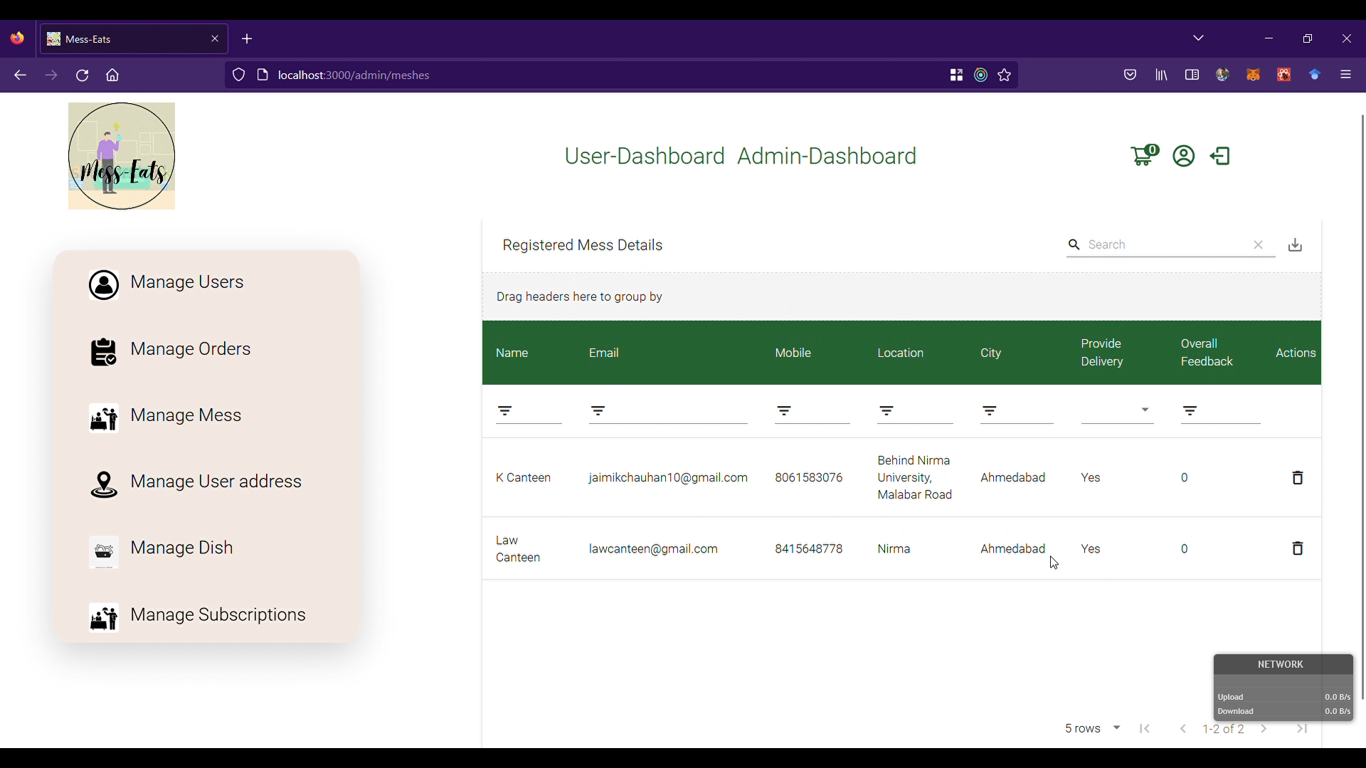
Admin Module (Manage Meshes)
Fig 1.6 Manage Meshes

Slide 18
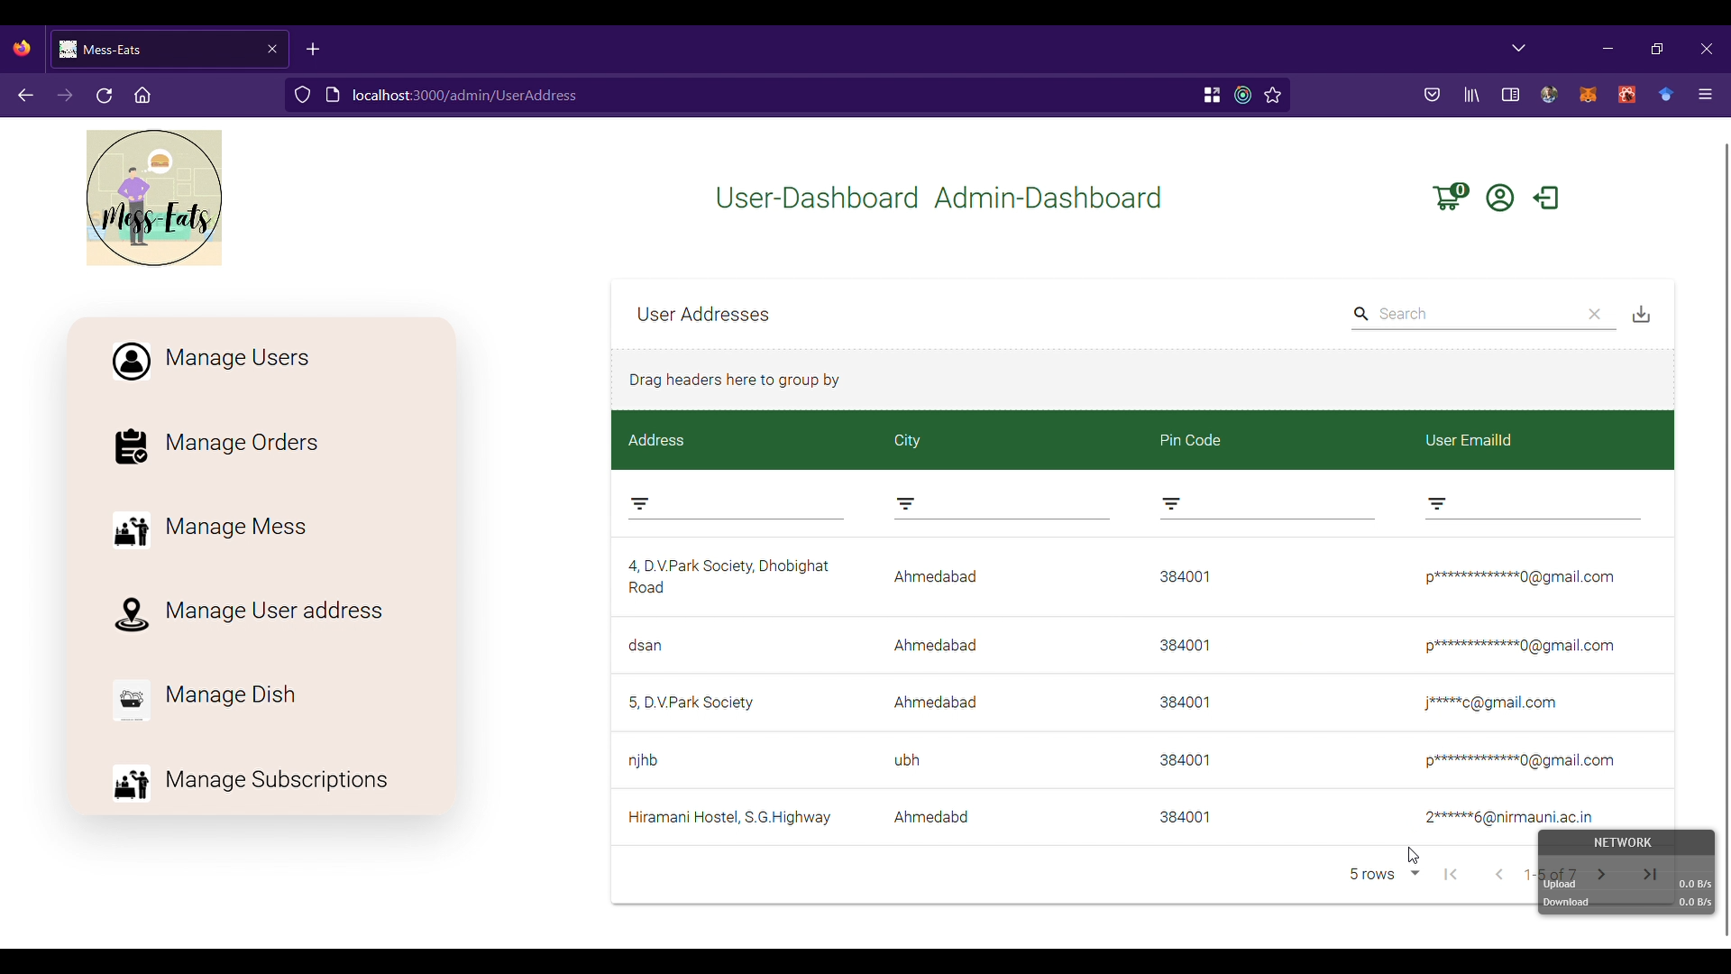
Admin Module (Manage User Address)
Fig 1.7 Manage User Address

Slide 19
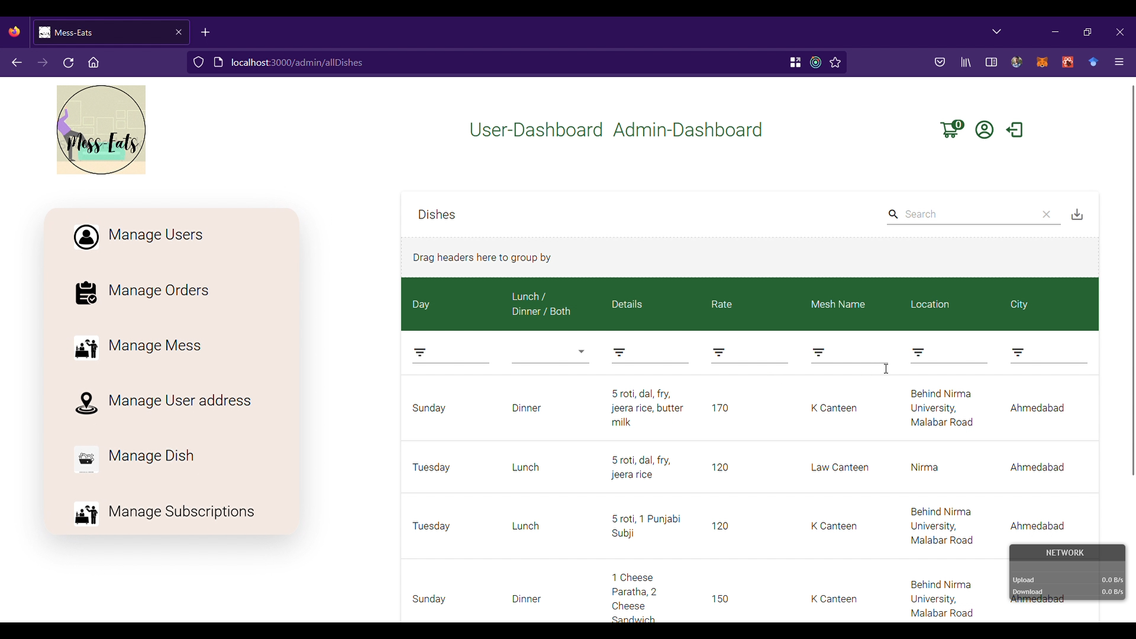
Admin Module (Manage Mesh Dishes)
Fig 1.8 Manage Mesh Dishes

Slide 20

Admin Module (Manage Subscription)
Fig 1.9 Manage Subscription

Slide 21
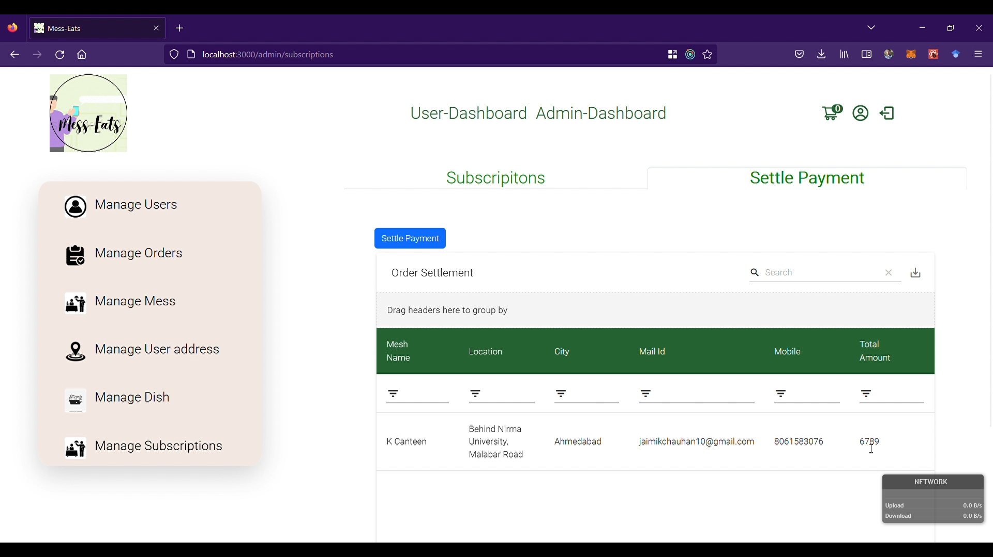
Admin Module (subscription settlement)
Fig 1.10 Settle Subscription Payment

Slide 22
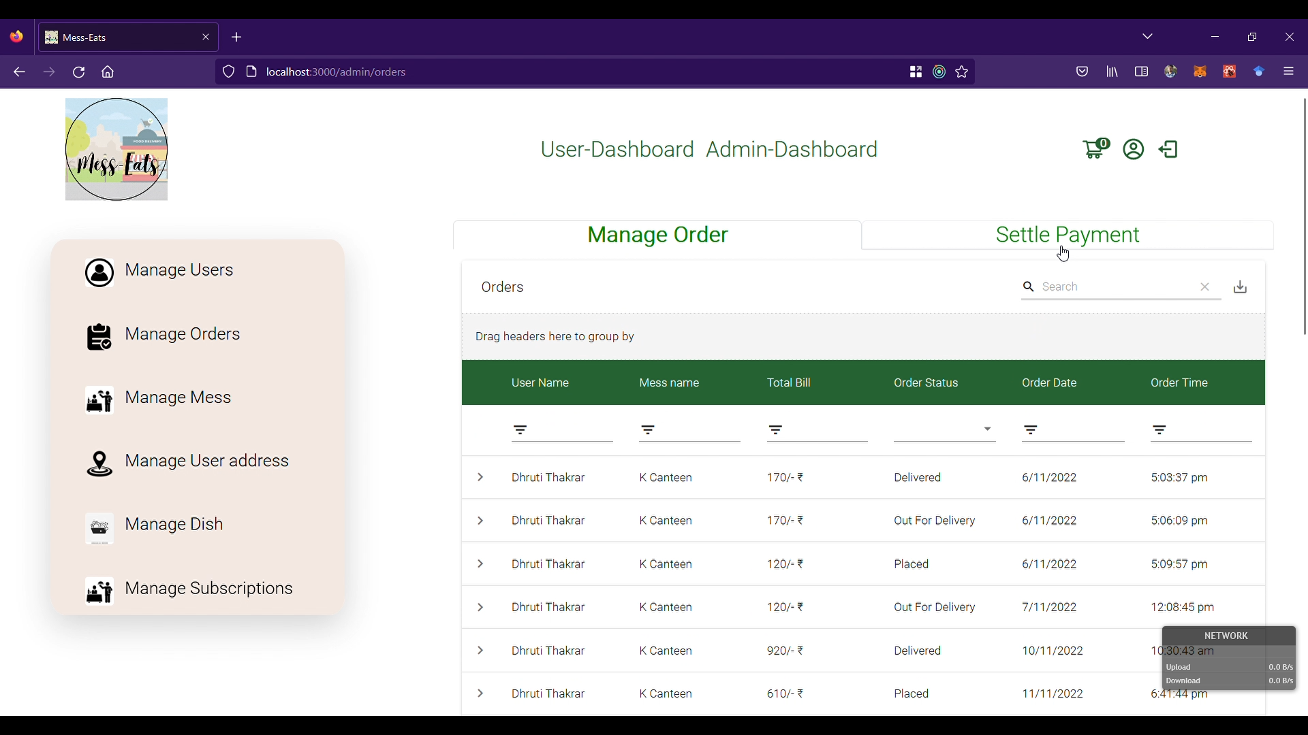
Admin Module (Manage orders)
Fig 1.11 Manage Orders

Slide 23

Admin Module (orders Settlement)
Fig 1.12 Settle Order Payment

Slide 24
User Module

Slide 25
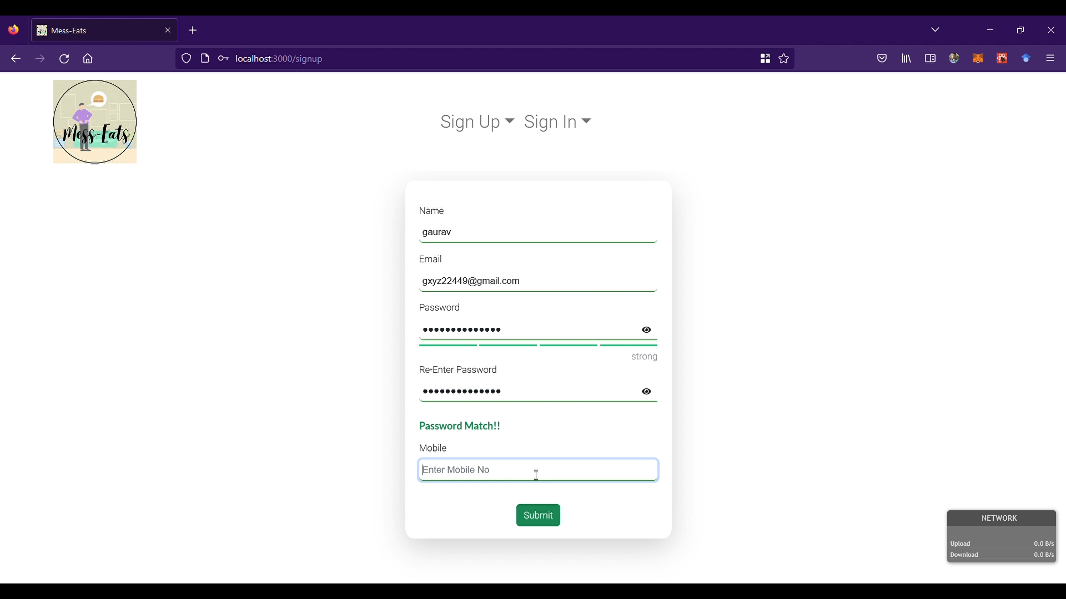
User Module (User sign up page)
Fig 2.1 User Sign Up Page

Slide 26
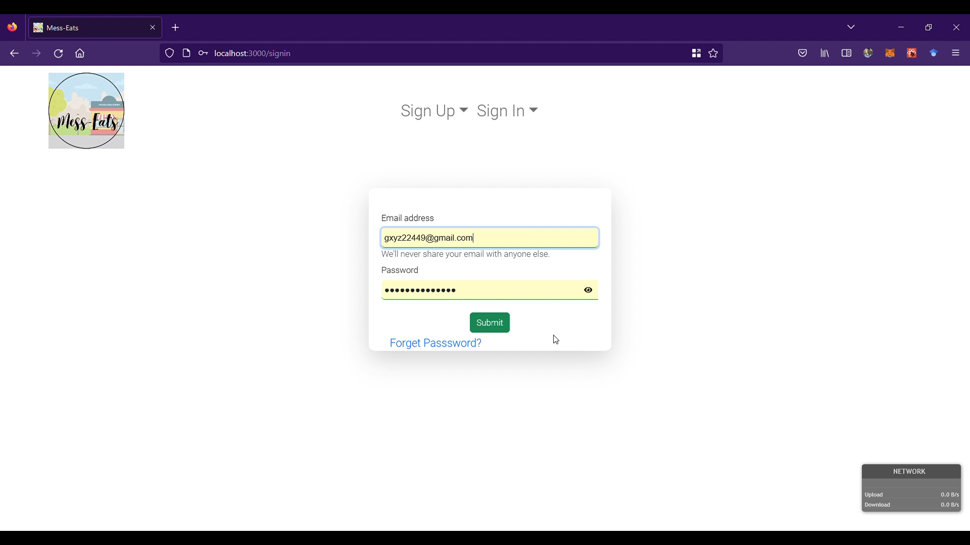
User Module (User sign in page)
Fig 2.2 User Sign In Page

Slide 27
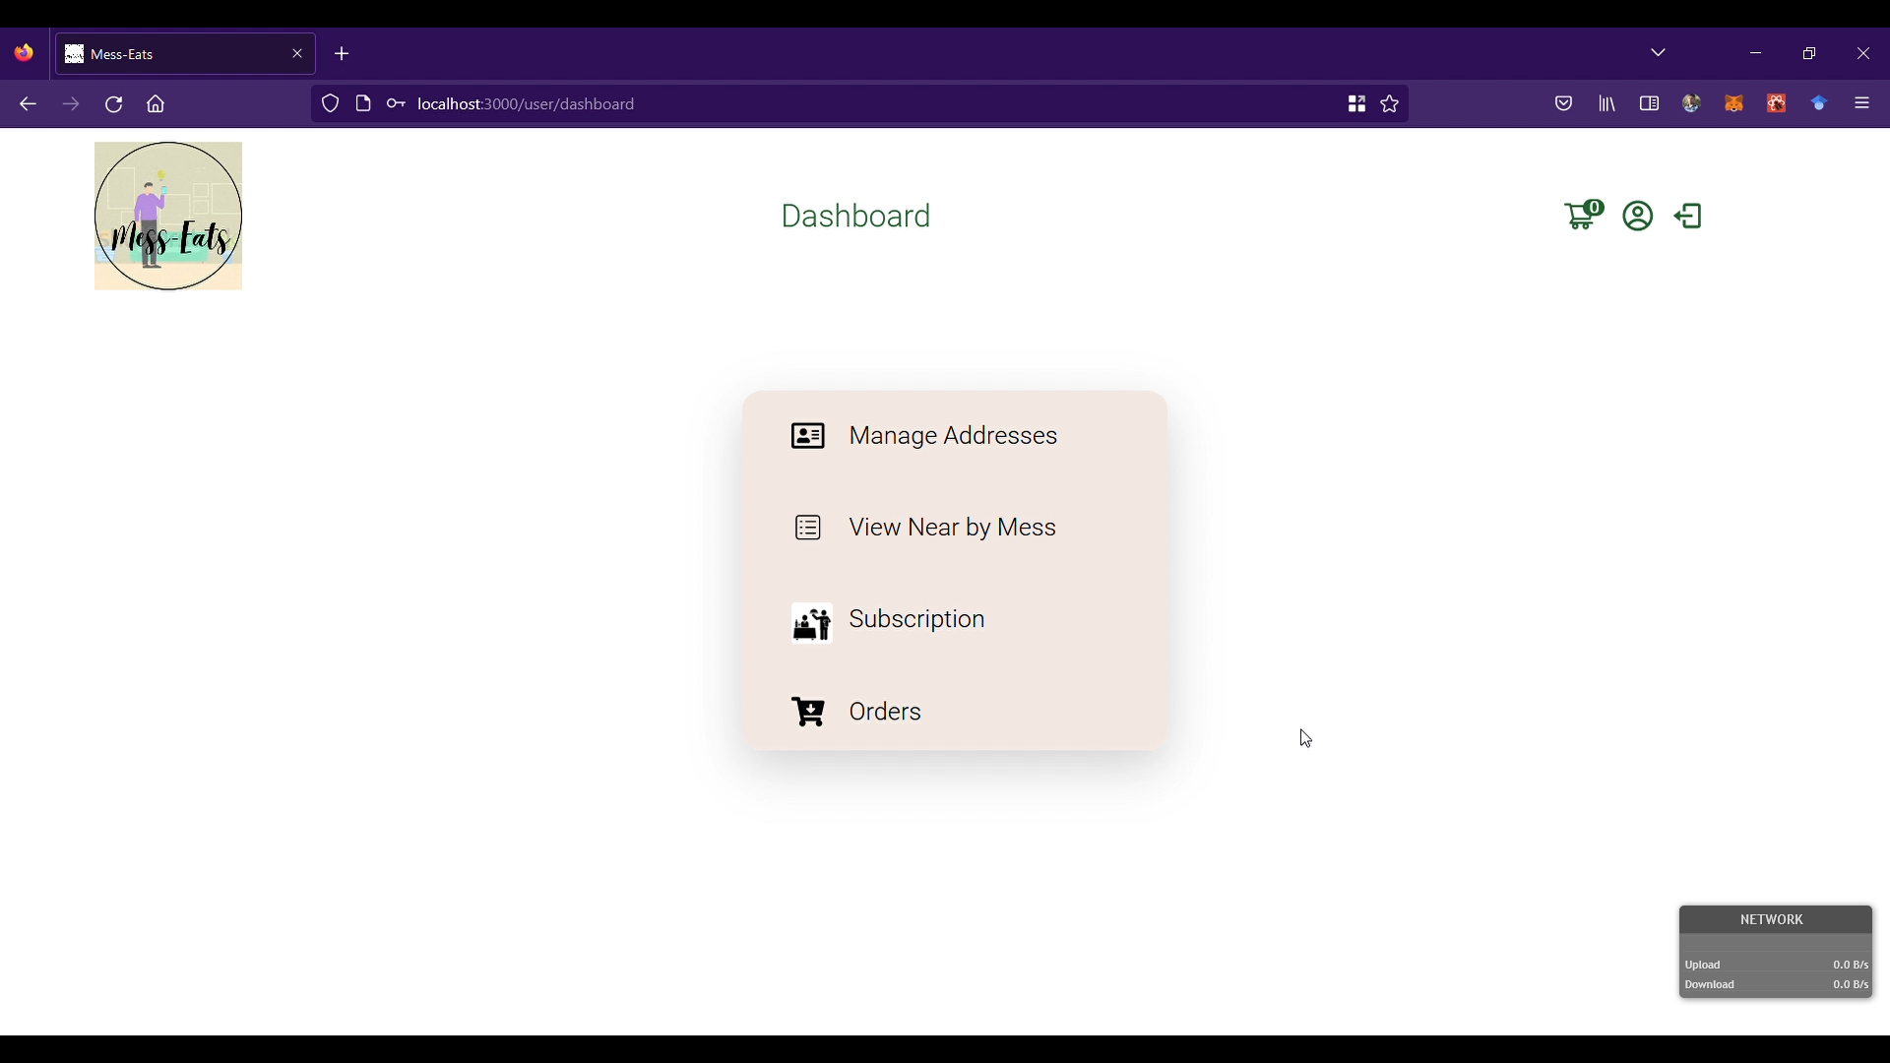
User Module (User dashboard)
Fig 2.3 User Dashboard

Slide 28
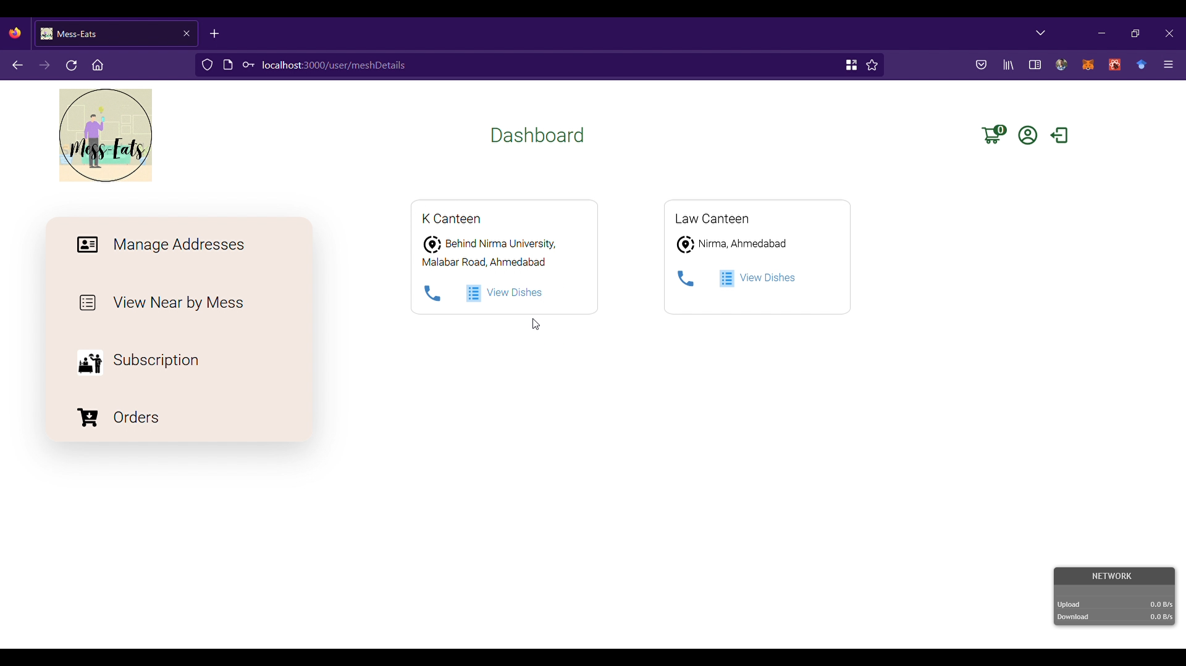
User Module (View mess)
Fig 2.4 View Mess

Slide 29
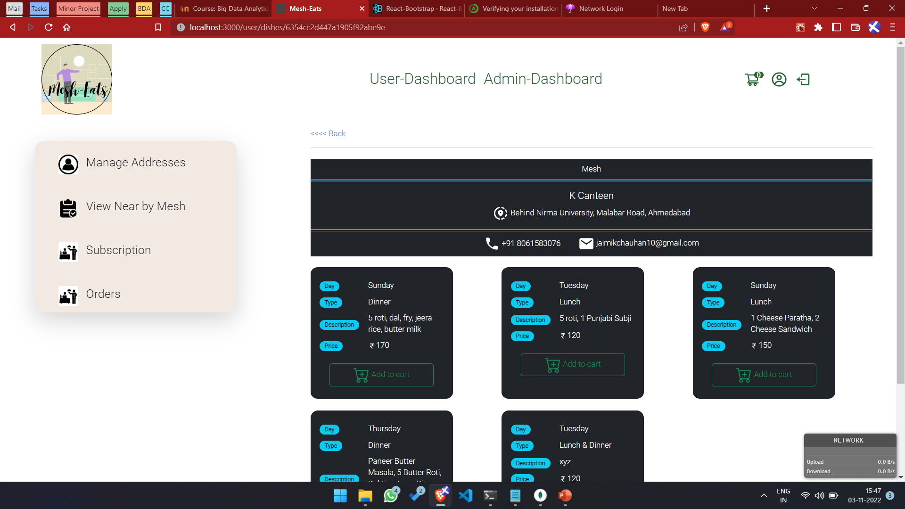
User Module (View Mess Dishes)
Fig 2.5 View Mess Dishes

Slide 30
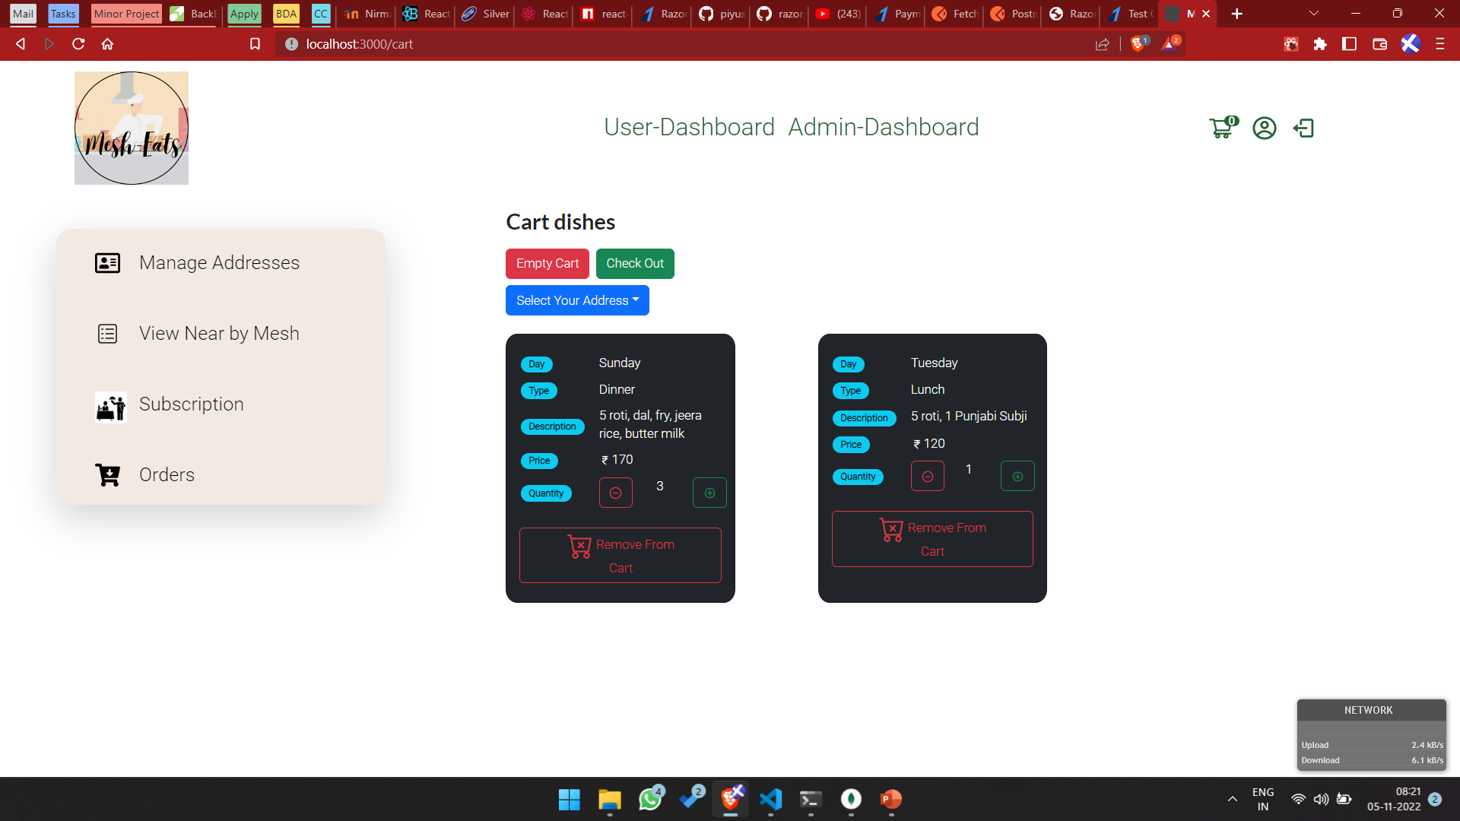
User Module (user cart)
Fig 2.6 User Cart

Slide 31
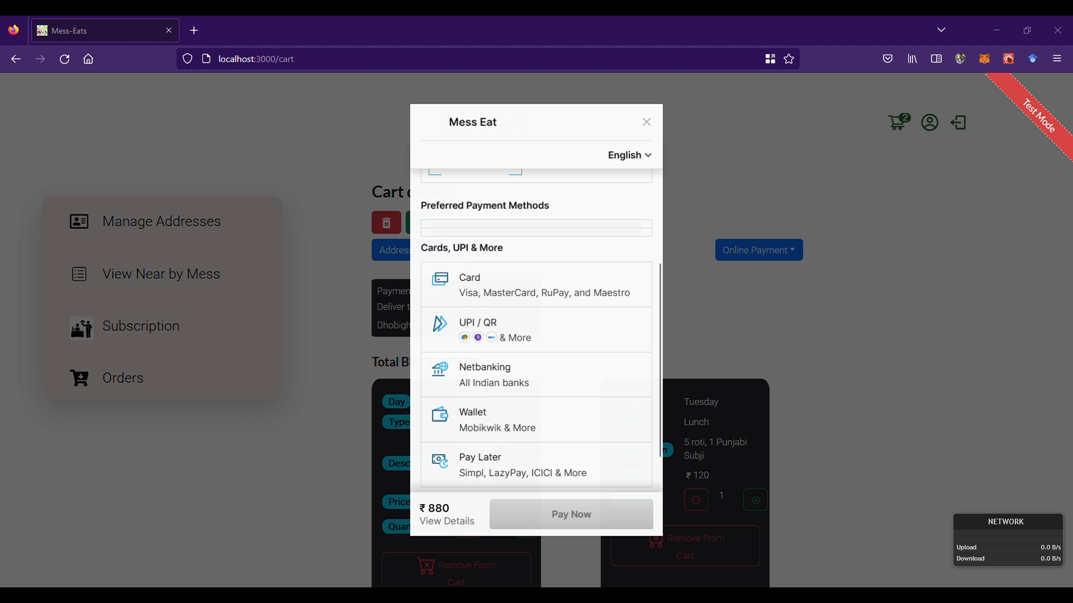
User Module (Online payment)
Fig 2.7 User Cart

Slide 32
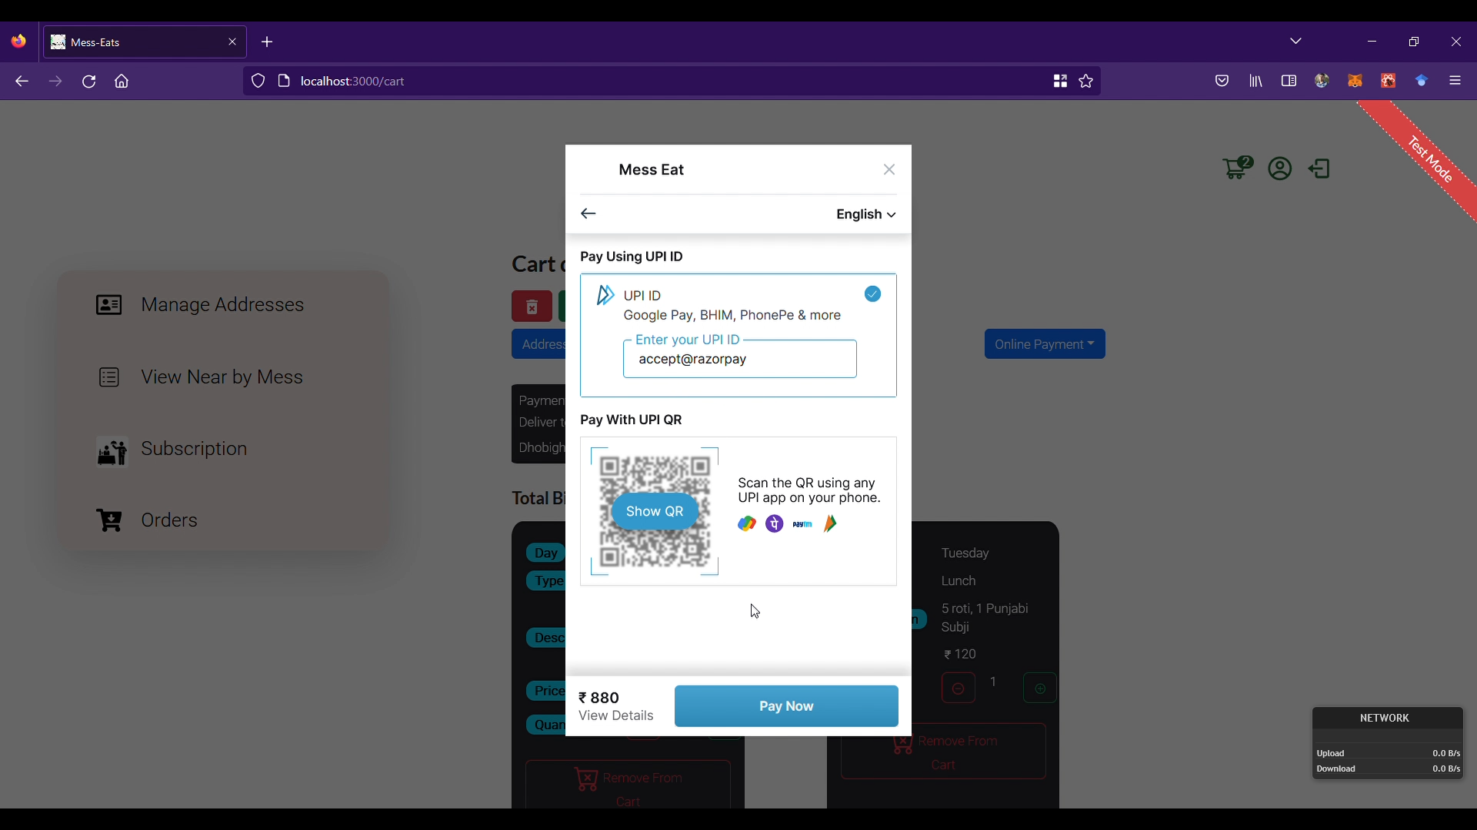
User Module (Online payment)
Fig 2.8 User Cart

Slide 33
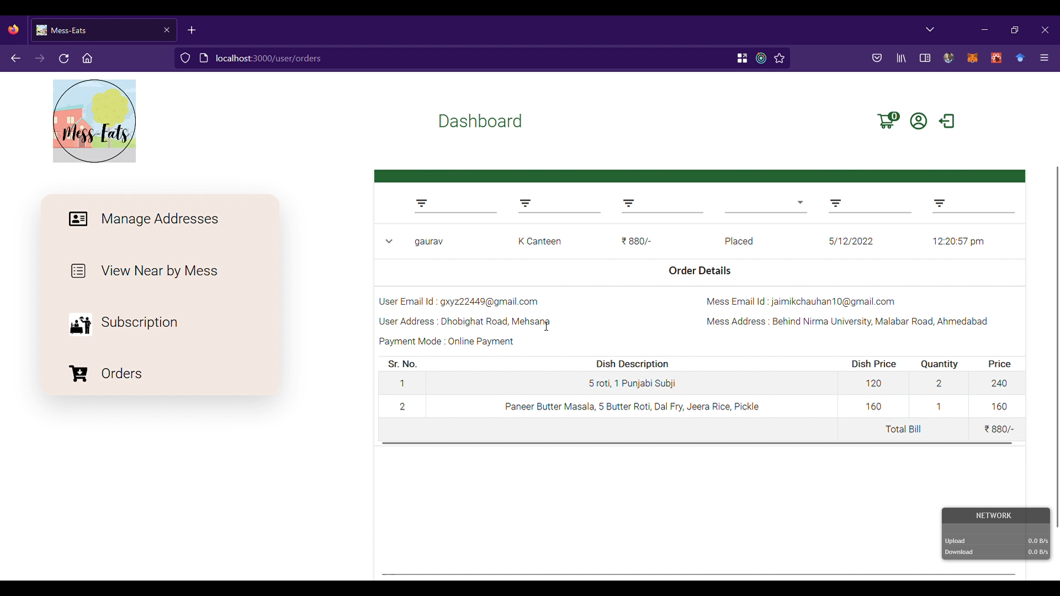
User Module (user orders)
Fig 2.9 User / Admin Profile

Slide 34
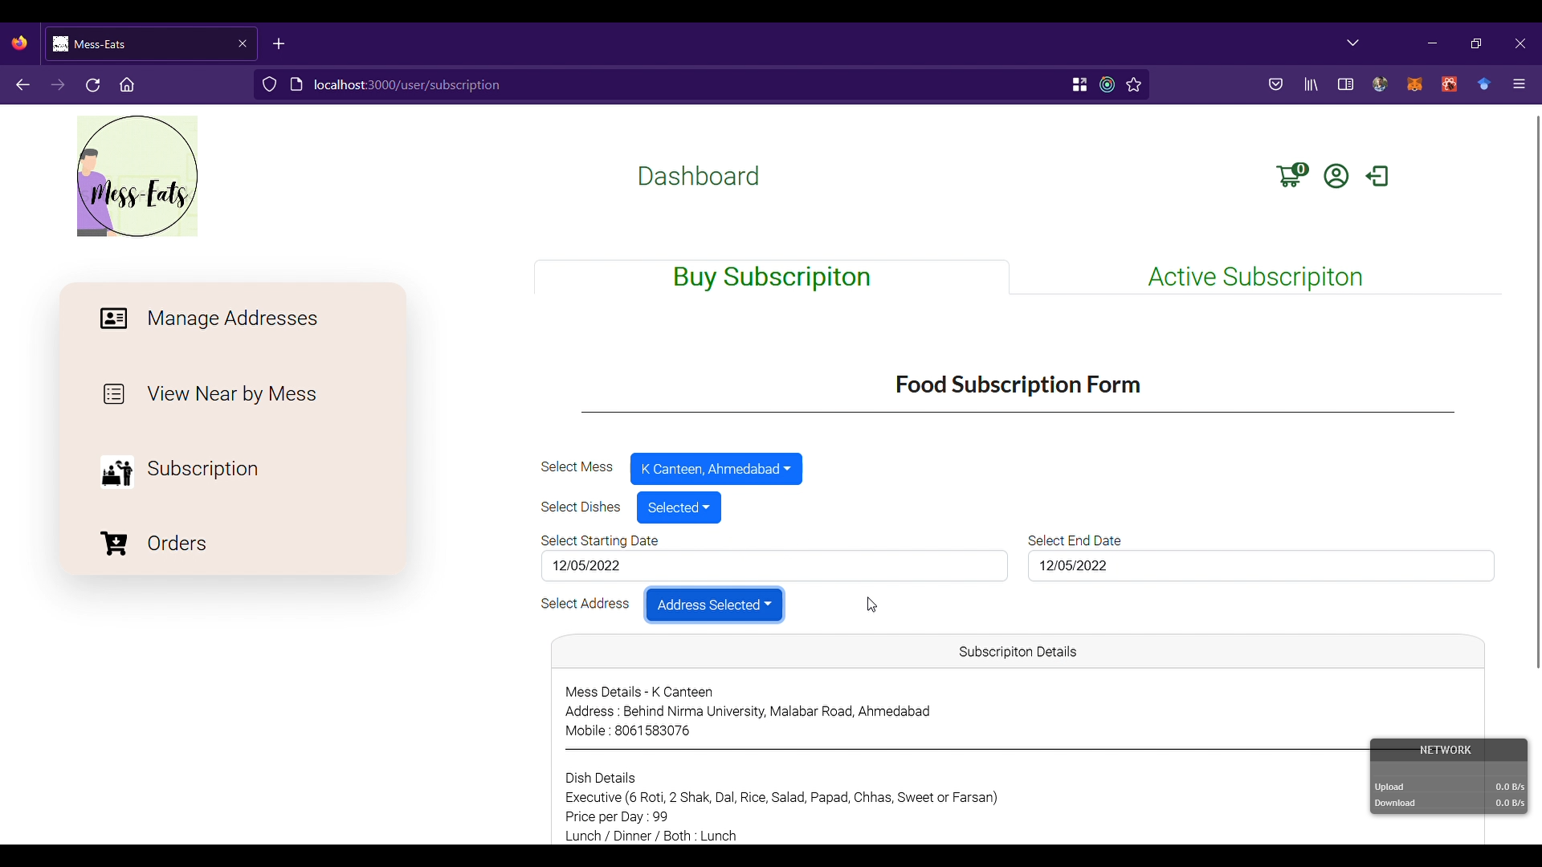
User Module (buy subscription)
Fig 2.10 User / Admin Profile

Slide 35
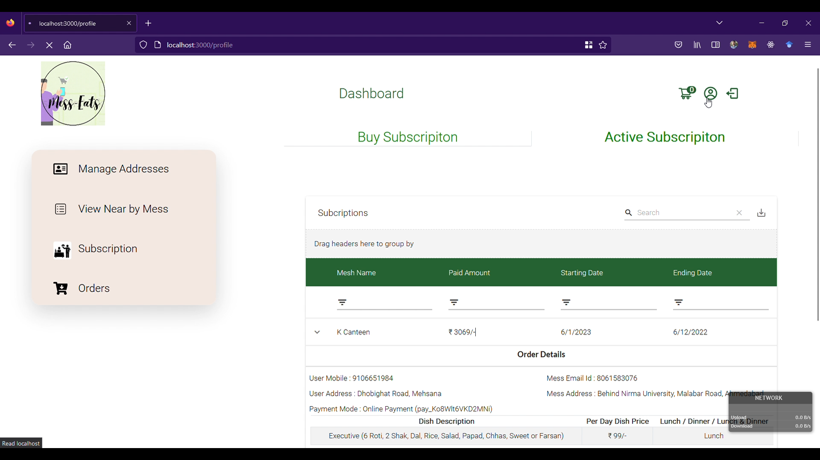
User Module (active subscription)
Fig 2.11 User / Admin Profile

Slide 36
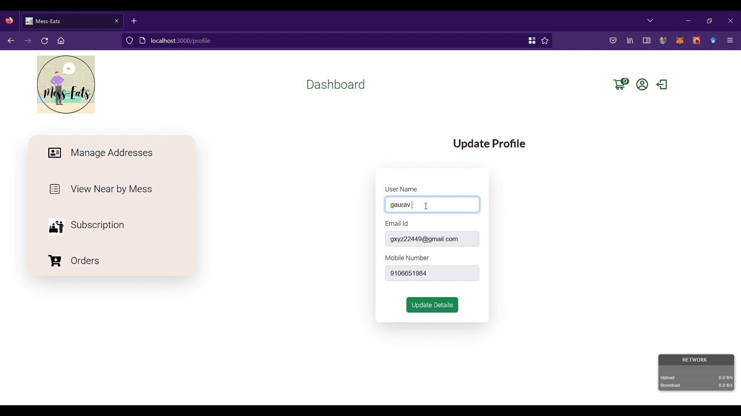
User Module (user/admin profile)
Fig 2.12 User / Admin Profile

Slide 37
Mess user Module

Slide 38
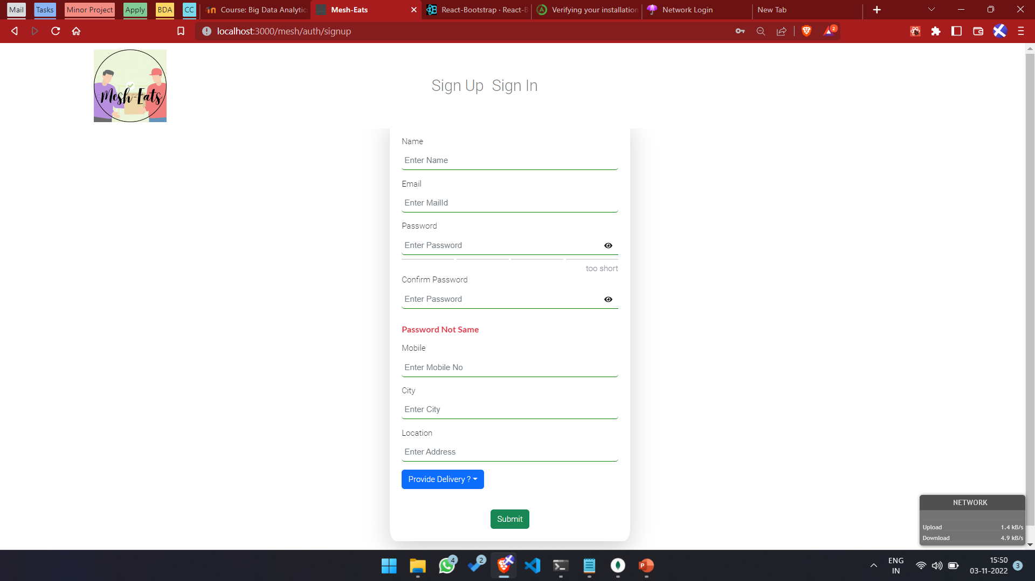
Mess-User Module (mess user signup page)
Fig 3.1 Mess User Signup Page

Slide 39
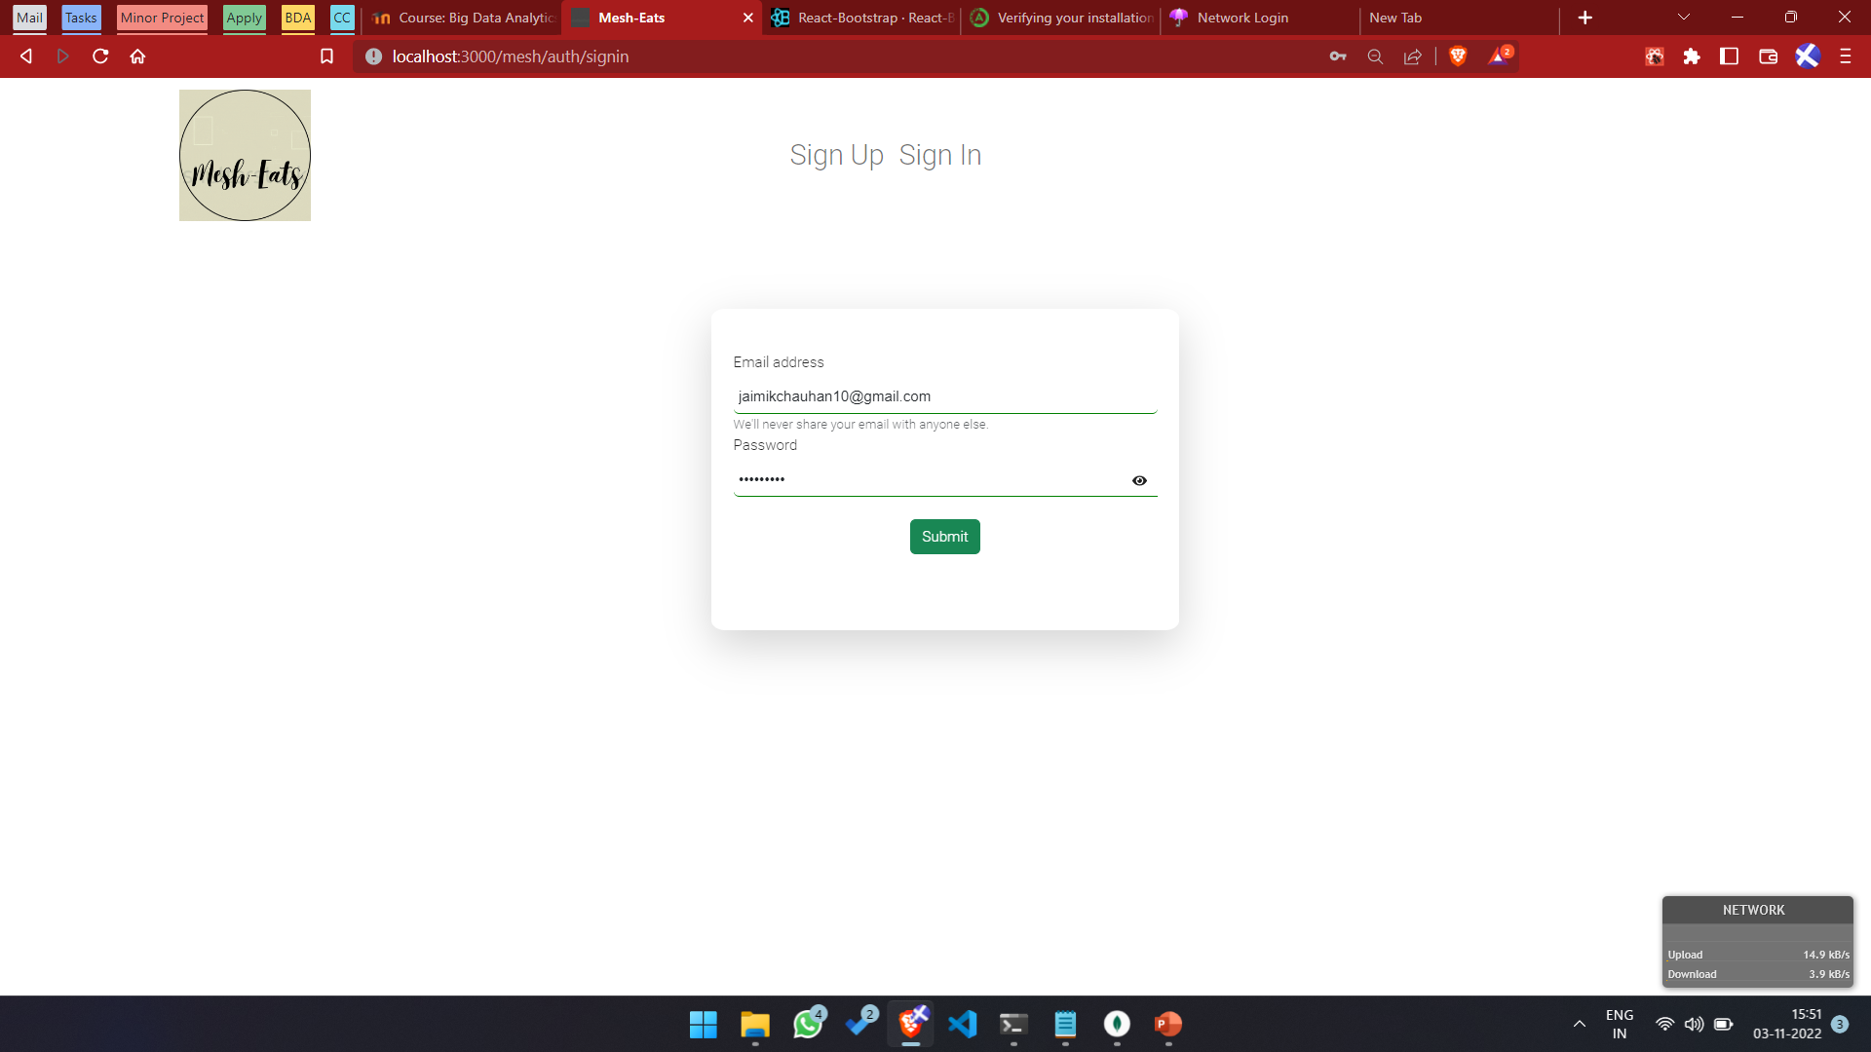
Mess-User Module (mess user signin page)
Fig 3.2 Mess User Signin Page

Slide 40
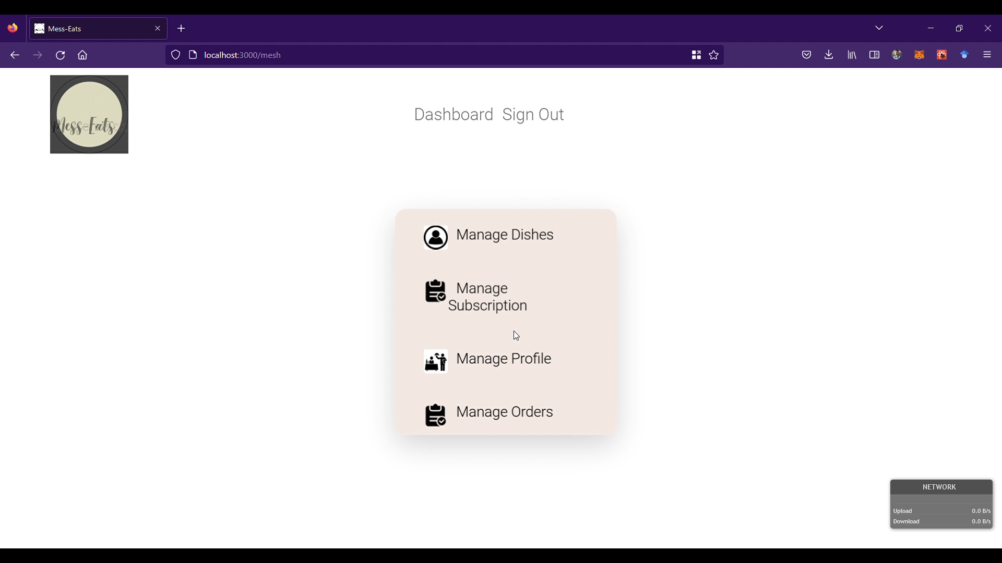
Mess-User Module (mess user home page)
Fig 3.3 Mess User Home Page

Slide 41
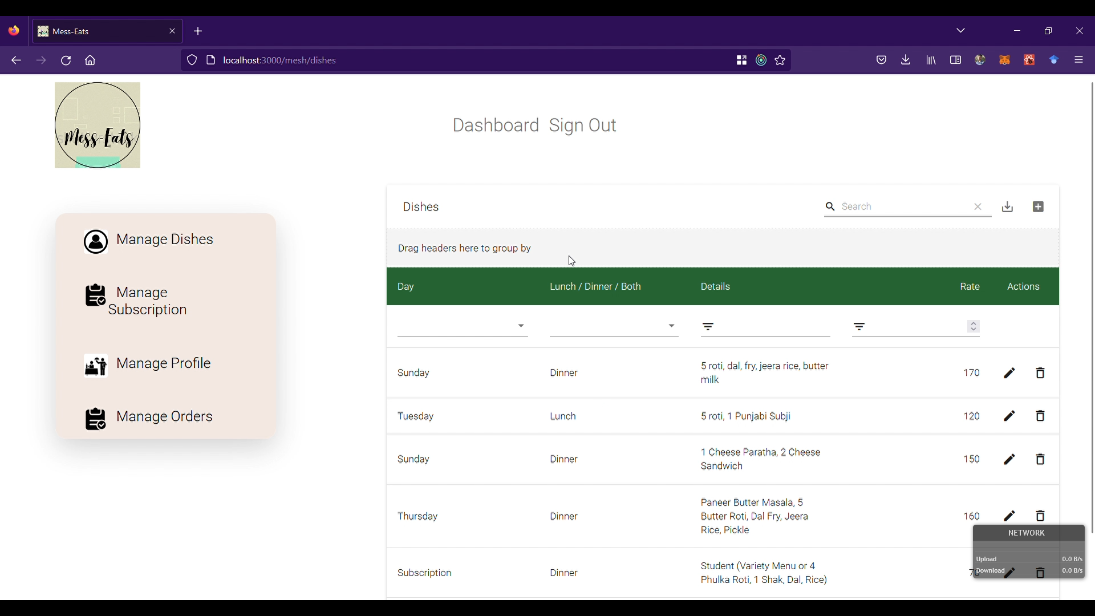
Mess-User Module (manage dishes)
Fig 3.4 Manage Dishes

Slide 42
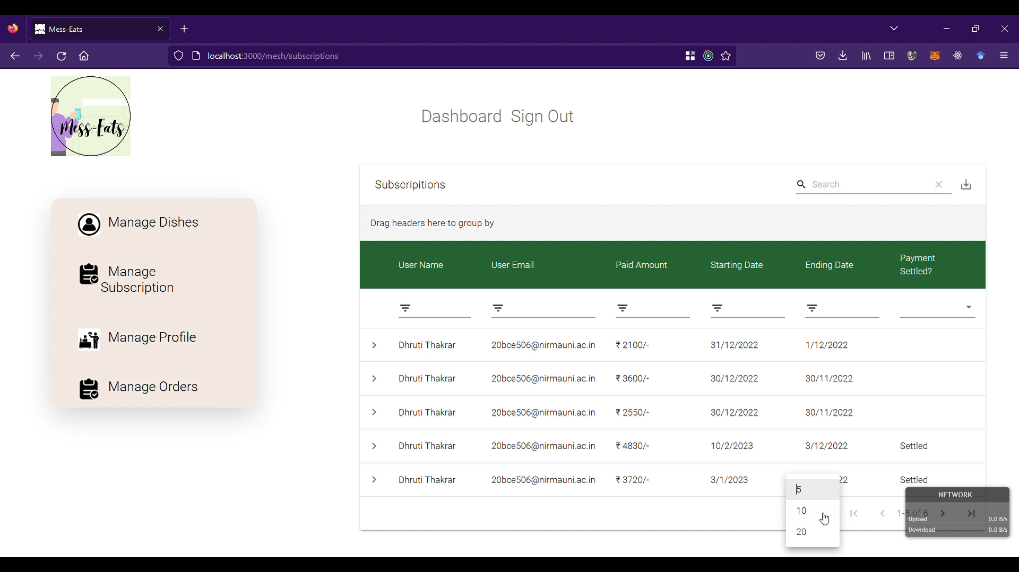
Mess-User Module (manage subscription)
Fig 3.5 Manage Subscription

Slide 43
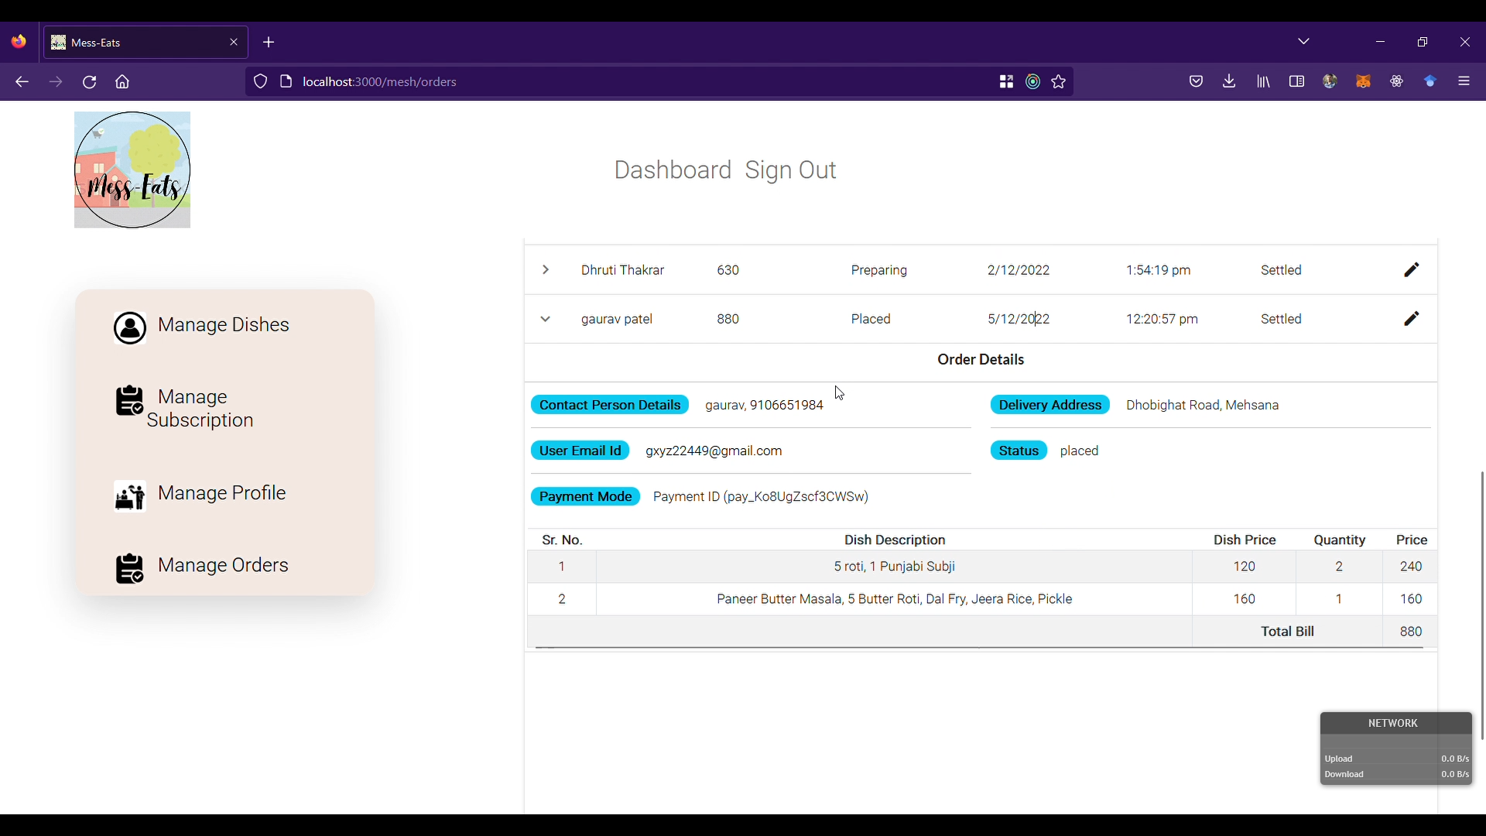
Mess-User Module (manage orders)
Fig 3.6 Manage Orders

Slide 44
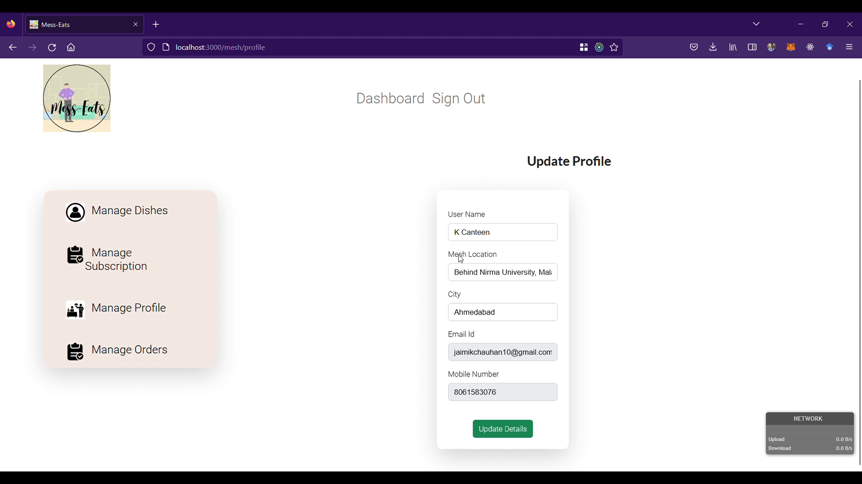
Mesh-User Module (Manage profile)
Fig 3.7 Manage Profile

Slide 45
Future work
Future Work
Identify User location
Payment Transfer

Slide 46

Thank You

